Slide 1
Analyzing Health Equity Using Household Survey Data
Lecture 14
Who Benefits from Health Sector Subsidies?
Benefit Incidence Analysis
Notes:
In this lecture we make the first application of the tools and techniques covered in the preceding lectures. The topic concerns the distribution of health care in relation to a measure of living standards and so the tools used will be those of the concentration curve and index.

Slide 2
Pro-poor public spending on health care
is an important objective of governments and international agencies.
This may derive from distributional concerns and/or from human capital/economic growth strategy.
So, are public subsidies targeted on the poor?
Notes:
1. Who gains most from public spending on health care? Is it the poor? Or does a substantial proportion, even a disproportionate proportion, of the spending go to the economically better-off? These are the questions important addressed by benefit incidence analysis (BIA).

Slide 3
Which benefit incidence analysis?
BIA describes distribution of public spending, e.g. on health care, across population ordered by living standards or other socioeconomic /geographic characteristic.
Simple BIA determines who receives how much of public spending $.
Behavioral BIA seeks to establish extent to which public spending changes the distribution of income.
  Requires estimating behavioral responses e.g. crowd-out of private health care
Marginal BIA seeks to establish who gains from marginal increases in public spending.
Here confine attention to distribution of average spending and abstract from behavioral responses.

Slide 4
Measure of living standards
Here we focus on the distribution of public health care in relation to living standards and not location, ethnicity, gender, etc
Any measure of living standards discussed in lecture 6 could be used
If use ordinal measure, e.g. wealth index, then can only determine whether distribution is pro-poor, or pro-rich
With a cardinal measure, e.g. income, can establish extent to which public spending is pro-poor
Notes:
1. Note, latter may be achieved to varying degrees depending on the extent to which behavioral responses to the public spending are taken into account.

Slide 5
Three steps of BIA
Estimate distribution of utilisation of public health services in relation to measure of living standards
Weight units of utilisation by value of subsidy and aggregate across health services
Evaluate by comparing the distribution of subsidies with some target distribution

Slide 6
Data for estimating the distribution of public health care utilisation should
Be at household level from health /socioeconomic survey
Give health care utilisation and living standards measure for same observations
Distinguish between use of public and private care (only interested in former)
Distinguish (at least) between:
  Hospital inpatient care
  Hospital outpatient care
  Non-hospital care (visits to doctor, health centre, polyclinic, antenatal)
Vary recall periods with frequency of use of service
Notes:
Only health services that are subsidized from the state-controlled budget should be considered. Public health programs and services financed from Overseas Development Assistance (ODA), user fees, and social insurance are relevant, provided the respective revenues are used at the discretion of the state. Difficulties arise if a survey does not distinguish between public and private care. In that case, private insurance cover, if available, might be used to distinguish between public and private patients. Otherwise, a BIA can be conducted only if the private sector is sufficiently small such that it can be ignored.
The recall periods for health care utilization should be sufficiently long such that the sample of observed users is not too small but not too long such that recall bias is large. For health services that have a higher frequency of utilization, such as ambulatory care, the optimal recall period is probably in the range of 2 to 4 weeks, and most surveys use a period in this range. For inpatient care, the recall period should be longer. It is typically 12 months.

Slide 7
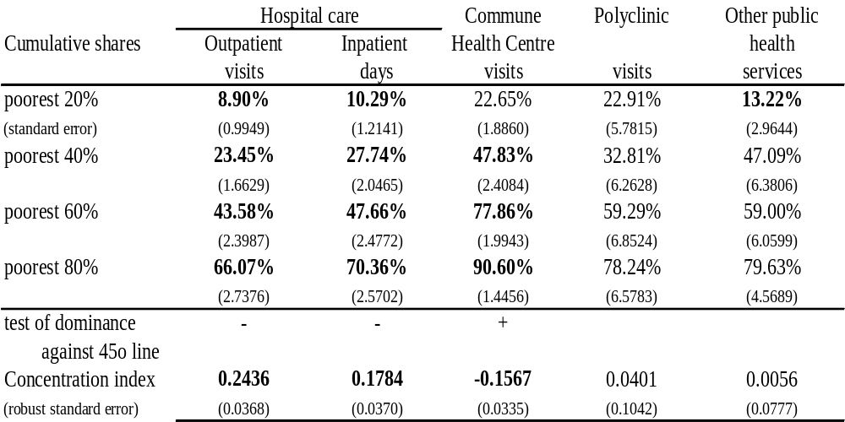
Distribution of Public Health Care Utilization in Vietnam, 1998
Notes:
Source: Authors’ calculations from Vietnam Living Standarss Survey 1998.
Table gives the cumulative shares of each type of public health care utilisation by quintiles of household consumption per equivalent adult.
Poorer groups receive less than their population share of hospital care at all quintiles. This is confirmed by tests indicating that the 45-degree line dominates both concentration curves for hospital care. This pro-rich bias is also indicated by the concentration indexes, which are positive and significantly different from zero. In contrast, utilization of commune health centers is pro-poor. There is no significant bias in the utilization of polyclinics and other public health services.
Standard errors are in parentheses.
For shares, bold indicates significant difference from population share at 5%.
For concentration indices, bold indicates significant difference from zero at 5%.
Standard errors for concentration indices are robust to heteroscedasticity and
within cluster (commune) correlation.
Dominance tests: - indicates the 45 degree line dominates the concentration curve (pro-rich)
+ indicates concentration curve dominates 45 degree line (pro-poor)
blank indicates non-dominance.
Dominance is rejected if there is at least one significant difference in one direction and no significant
difference in the other, with comparisons at 19 quantiles and 5% significance level.
Quintile shares and their standard errors were computed, along with the dominance tests, using the
dominance ado described in chapter 7. Concentration indices computed as described in chapter 8.

Slide 8
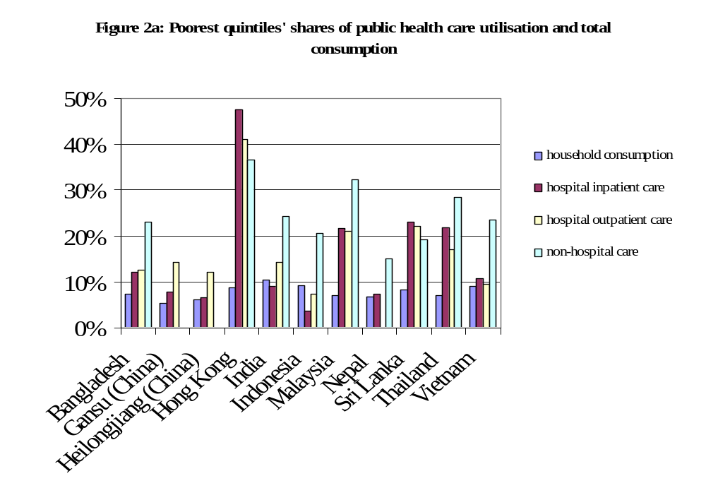
The poor’s share of public health care in Asia (Equitap)
Notes:
Source Derived from O’Donnell, van Doorslaer et al (2007) The incidence of public spending on health care: comparative evidence from Asia, World Bank Economic Review, 2007, 21 (1): 93-123. Referred to below as EQUITAP study.
In all countries with the exception of Hong Kong, Malaysia, Sri Lanka and Thailand, the poorest 20% of the population receive much less than 20% of public hospital (inpatient and outpatient) care. Non-hospital care is distributed more favourably toward the poor.

Slide 9
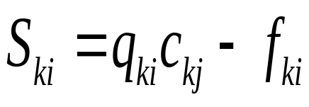



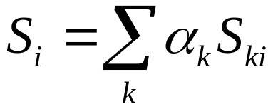

Computation of the public health subsidy
Value utilisation to allow for variation in subsidy across services, facilities, regions and individuals, and to aggregate across services
Service-specific subsidy received by individual (i)
where is utilisation of service k, is the unit cost of
k in region j where i resides and is the fee paid.
Total subsidy to individual:
where adjust for differences in recall periods
Notes:
1. One might standardize on the recall period that applies for the service accounting for the greatest share of the subsidy. For example, where this is inpatient care, reported over a one-year period, then a_k=1 for inpatient care and, for example, a_k=13 for services reported over a 4-week period.

Slide 10
Calculation of unit costs
Units costs derived from total public recurrent expenditure on health care
Disaggregate this down to geographic region, then to facility (hospital, health centre etc.), then by service (inpatient, outpatient, etc)
Ideally National Health Accounts are available to do this
If accounts data do not allow disaggregation by region and facility, all units of a given service must be weighted equally. Then aggregation across services is only purpose served by application of unit subsidies.
Service specific cost data can be difficult to obtain given joint use of many health care resources. Facility-level cost surveys can be useful.
Notes:
If accounts are not sufficiently detailed to allow net public expenditure to be identified by region and facility, then all units of a given service must be weighted by the same unit subsidy estimated. In such circumstances, aggregation across services is the only purpose served by application of unit subsidies. Within a particular service, the distribution of the subsidy and the distribution of raw utilization will differ only in their means. Nevertheless, such aggregation can still be informative, allowing the incidence of the total health sector subsidy to be established and this incidence to be decomposed into that arising from differential use of services and that arising from differential subsidies across services.
Moving from facility-specific to service-specific expenditures can be difficult given the joint use of many health resources across a range of services. The detailed information necessary to distinguish between expenditures on, for example, outpatient and inpatient services might be available only from facility-level cost surveys. Data from such surveys can be used to estimate cost functions from which the unit costs of services can be recovered. Without NHA, disaggregation of public health expenditures down to the service level is likely to prove difficult and require the imposition of various assumptions and approximations. The robustness of results to these approximations should be checked through sensitivity analysis.

Slide 11
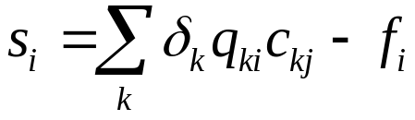
Taking account of user fees
Simplest method - divide aggregate official user fee revenue by estimate of total utilization and assign average to all users
If net public expenditure available by region-facility-service, then get variation in fee payments at that level
If survey provides data on payments, then can have individual variation in fees
If survey only gives amount paid for all services, then compute subsidy to indv. by
Notes:
where f_i is the payment for all public health care and d_k is a scaling factor that standardizes the recall periods for the utilization variables on the recall period that applies to the total payment variable.

Slide 12
Discrepancies between reported and official user fees
can be substantial and due to revenue being kept locally either officially or unofficially
Appropriate treatment of user fees then depends on objective:
  If to identify distribution of central govt. net expenditure, then payments in excess of official revenue can be ignored
  But if seek distribution of net benefits, then payments made by indv. are relevant irrespective of whether official
    If payments made to finance costs not covered by govt. budget, then cancel out from net benefit calculation
    If payments are rent to providers, then should be subtracted in net benefit calculation
Notes:
1. Survey estimates of aggregate user fee revenues may not match the official figures. Apart from sampling and nonsampling error, the discrepancy can be explained by payments that are kept locally and not remitted to the central administration or by unofficial payments that are paid not to the facility but to personnel at the facility. The appropriate treatment of user payments in such cases depends on the objective of the analysis. If it is simply to identify the distribution of net expenditures made by the central government in an accounting fashion, then reported payments in excess of official revenue could be ignored. However, if the aim is to identify the incidence of net benefits from government-supported health services, then one seeks an estimate of the difference between the value of services consumed and the payments made for them by the individual, irrespective of whether all of the payment is remitted to the central government. In the instance that payments, official or unofficial, are made to fill the gap between the cost of the care provided and the available budget, then, in principle, they should be added to both costs and payments and so can be ignored in computation of the subsidy. On the other hand, if the payments are rent extracted by providers, then they reduce the real value of the subsidy to the individual and should be subtracted in calculation of the real subsidy. Most surveys do not distinguish between payments remitted to the center and those kept locally, and it is not possible to discern whether payments are used to raise quality or are rent extraction. The distribution of official user fee revenue remitted to the center could be estimated by scaling all reported payments by the ratio of total official user fee revenue to aggregate payments calculated from survey data. One could test the sensitivity of results to this treatment of payments against subtracting all payments reported in the survey. Waiting and travel time also reduce the net benefit from care received by the individual and should, in principle, be valued and subtracted in computation of the subsidy. Survey data do not, however, usually permit this.

Slide 13
In practice
survey data do not identify whether payments are centrally remitted, or if are rent extraction
Can estimate the distribution of official payments by scaling all payments by a constant equal to ratio of official to reported user fee revenue
Can test sensitivity of estimated subsidy distribution to this scaling of payments as opposed to subtracting all reported fees

Slide 14
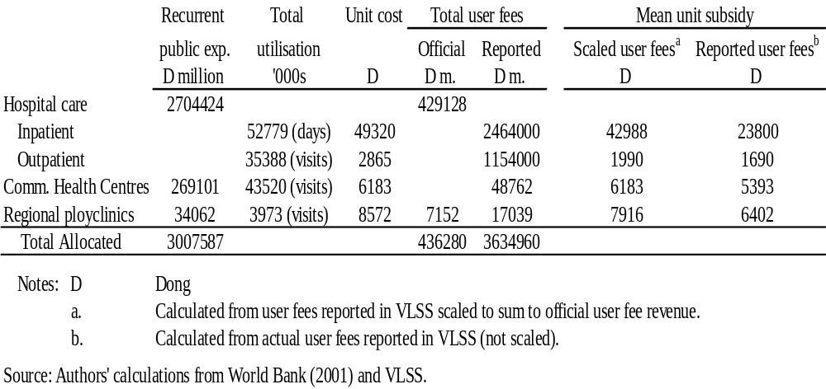
Public Health Expenditure, Unit Costs and Subsidies, Vietnam 1998
Notes:
National Health Accounts are not available for Vietnam, and so we estimate unit subsidies from public spending accounts. Total recurrent public expenditure on health was more than 5 trillion Vietnamese dong (D) in 1998 ($1 = D 13,987) (World Bank 2001). That covers all spending on health programs and services provided by public health facilities and financed from the state budget, user charges, social health insurance, and external donors. The public accounts do not disaggregate by facilities within regions. We therefore impose the same unit costs across all users irrespective of their geographic location. Although this is common practice in BIA studies (Castro-Leal et al. 2000), it is regrettable. It means that geographic variations in the quality, as opposed to the quantity, of health care are not taken into account. Such variations can be substantial (Das and Hammer 2005).
At the national level, the public accounts disaggregate central and provincial government recurrent health spending by facility, that is, hospitals, polyclinics, and commune health centers (World Bank 2001). Public spending financed from other sources is not disaggregated by facility. Because health insurance finances hospital care only, total revenue from health insurance is added to the government expenditure on hospitals (World Bank 2001).
Officially, user fees are charged for hospital and polyclinic care only. For baseline estimates, we divide total user fee revenue between hospitals and polyclinics in the same proportions as apply for government revenue (World Bank 2001).
Finally, total public spending financed from ODA (World Bank 2001) is divided between hospitals, polyclinics, and health centers in the same proportions as apply for central and provincial government expenditures. By that allocation method, we arrive at the facility-specific public expenditures given in the first column of the table below. The total across facilities represents 59 percent of total recurrent public health spending.
As is often the case, the accounts do not distinguish between hospital expenditures on inpatient and outpatient services. Cost function estimates from a survey of 80 percent of public hospitals (Weaver and Deolalikar 2004) give the cost of an inpatient day at more than 17 times that of an outpatient visit. From that estimate of relative cost, plus aggregate public expenditure on hospitals and the total utilization of the respective services, the unit costs of an inpatient day and outpatient visits are derived (see table above, column 3). The unit costs of visits to health centers and to polyclinics are calculated by dividing total public expenditures on these facilities by respective total utilization figures, estimated from the VLSS. The resultant costs seem somewhat high in comparison to the estimated unit cost of a hospital outpatient visit. In a full report, sensitivity of results to these estimates of unit costs would be checked.
There is a tremendous difference between reported payments for public health services and official user fee revenue in Vietnam. The official accounts indicate total user fee revenue of D 436 billion in 1998 (World Bank 2001). This is only one-eighth of the total amount individuals report paying for care in public hospitals, polyclinics, and commune health centers (excluding payments for drugs). In fact, the total amount reported in user payments exceeds total recurrent public expenditure on these services (see table above).
Given the difference between official and reported user payments, we experiment with two methods of calculating the public subsidy. In each case, we apply equations 14.1 and 14.2 above, but use different estimates of individual specific user payments. Under the first method (2nd from final column of the table above), we set user fees in commune health centers to zero (officially they do not exist) and scale reported user fees in hospitals and polyclinics by the ratio of official to reported aggregate user payments for these services. Under the second method (final column), we use the actual user fees reported for all services, not including payments for drugs. Patients are usually responsible for purchasing their own drugs. In both cases, we set negative values of the subsidy to zero.
Each mean unit subsidy given in the table indicates the average, across users, of the subsidy per unit of the respective service. So, for example, when user payments are scaled to sum to official fee revenue, inpatients receive a subsidy, on average, equal to almost D 43,000 per day, or more than 80 percent of the cost. However, the value of this subsidy falls by almost 50 percent if it is calculated on the basis of what patients actually report paying.

Slide 15
Evaluation of public health subsidy distribution against a target
implies choice of an objective.
Is subsidy pro-poor?
  Compare subsidy shares with population shares - check dominance of concentration curve against 45º
  Summarise by concentration index; positive if pro-rich, negative if pro-poor.
Does the subsidy reduce inequality?
  Compare subsidy shares with income shares – check dominance of concentration curve against Lorenz curve
  Summarise by Kakwani index (CI – Gini); positive if inequality-increasing, negative if inequality reducing
Notes:
The first question is relevant if the goal is to ensure that the subsidy is pro-poor, which requires that the subsidy concentration curve dominate the 45-degree line.
If the subsidy were considered part of an individual’s final income, then an alternative distributional objective would be for final income to be more evenly distributed than presubsidy income. That is, the subsidy should be inequality-reducing, closing the relative gap in welfare between the rich and the poor. This requires that the subsidy concentration curve dominate the Lorenz curve, which is obviously much less demanding than domination of the 45-degree line.
Domination of the Lorenz curve may be referred to as progressivity, or weak progressivity, of the subsidy, as opposed to absolute or strong progressivity in the case that the concentration curve dominates the 45-degree line (Castro-Leal et al. 2000; Sahn and Younger 2000).

Slide 16
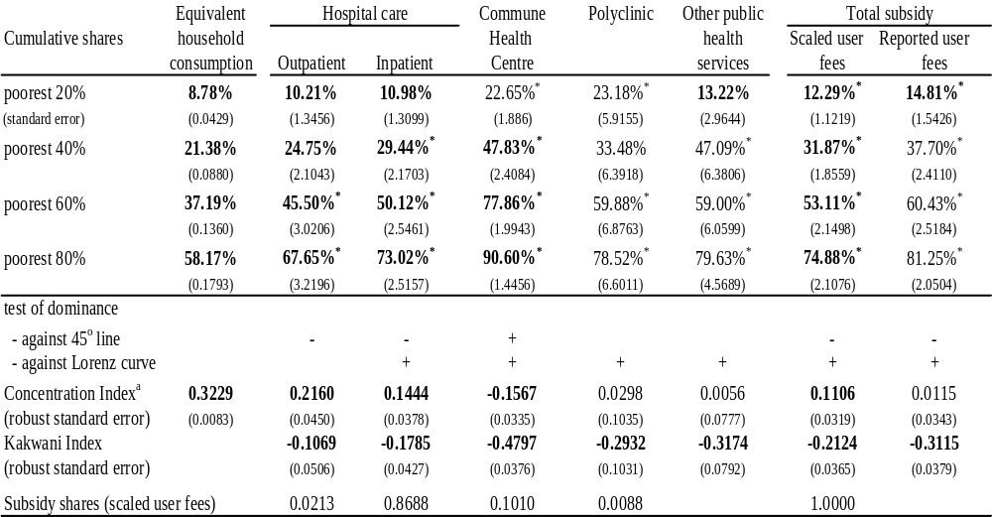
Distribution of public health subsidies in Vietnam, 1998
Notes:
1. For shares, bold indicates significant difference from population share (5%) and * indicates significant difference from consumption share (5%).
For concentration and Kakwani indices, bold indicates significant difference from zero at 5%.
Standard errors for concentration and Kakwani indices are robust to heteroscedasticity and
within cluster (commune) correlation.
Dominance tests: - indicates the 45o line / Lorenz curve dominates the concentration curve
+ indicates concentration curve dominates 45o line / Lorenz curve
blank indicates non-dominance.
Dominance is rejected if there is at least one significant difference in one direction and no significant
difference in the other, with comparisons at 19 quantiles and 5% significance level.
a. Gini index for equivalent household consumption.
2. In the table below, we present cumulative quintile shares of the service-specific subsidies and for the total subsidy across all services. In computing the service-specific quintile shares, we scale all user payments to sum to official user fee revenue (see box 14.2). The subsidy shares are broadly consistent with those for raw service utilization given in the table in box 14.1. Cumulative quintile shares for the total subsidy are given both with and without scaling user payments. Irrespective of the treatment of user payments, the poorest quintile’s share of the subsidy is less than 20 percent but greater than its share of total consumption. At higher quintiles, the cumulative subsidy shares deviate from the respective population share only if reported user payments are scaled. However, tests indicate that the subsidy concentration curve is dominated by the 45-degree line under both treatments of user payments and that it always dominates the Lorenz curve. Subsidy concentration curves (with scaled user payments) and the Lorenz curve are graphed in the figure. The concentration curve for the total subsidy follows that of the inpatient subsidy most closely. This reflects the fact that inpatient care receives by far the largest share of public spending in Vietnam (87%—see table below).
3. With one exception (outpatient), the dominance tests and the Kakwani indices services indicate that the subsidies are inequality-reducing or weakly progressive. But only the subsidy to commune health centers is pro-poor or strongly progressive. The subsidy to hospital care and the total subsidy are pro-rich. It may be concluded that public health care subsidies in Vietnam help close the relative gap in welfare between rich and poor but raise the absolute gap.

Slide 17
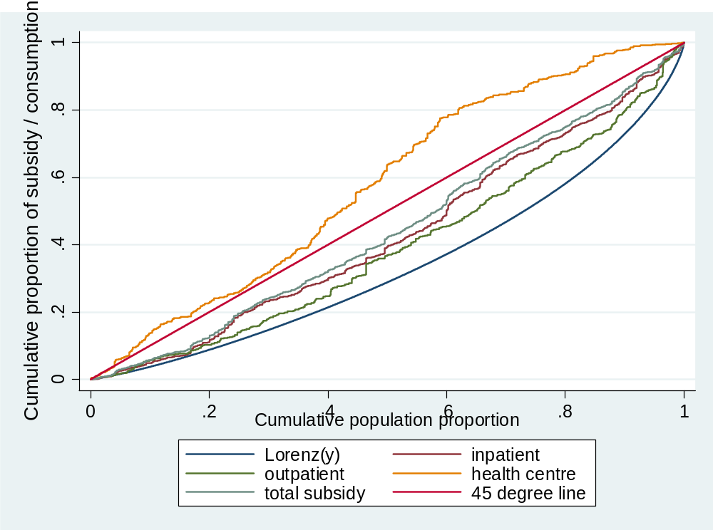
Concentration curves for health sector subsidies in Vietnam, 1998

Slide 18
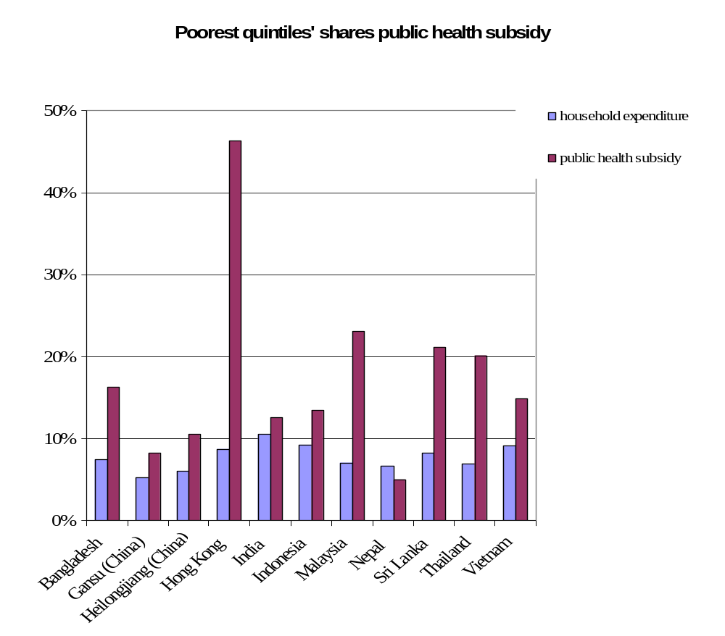
Poor’s share of public health subsidy in Asia
Notes:
Derived from O’Donnell, van Doorslaer et al (2007) World Bank Economic Review .
With the exception of Hong Kong, Malaysia, Sri Lanka and Thailand, the poor get much less that their population share of the public health subsidy.
But in most countries the poor get a greater share of the subsidy than they have of income.

Slide 19
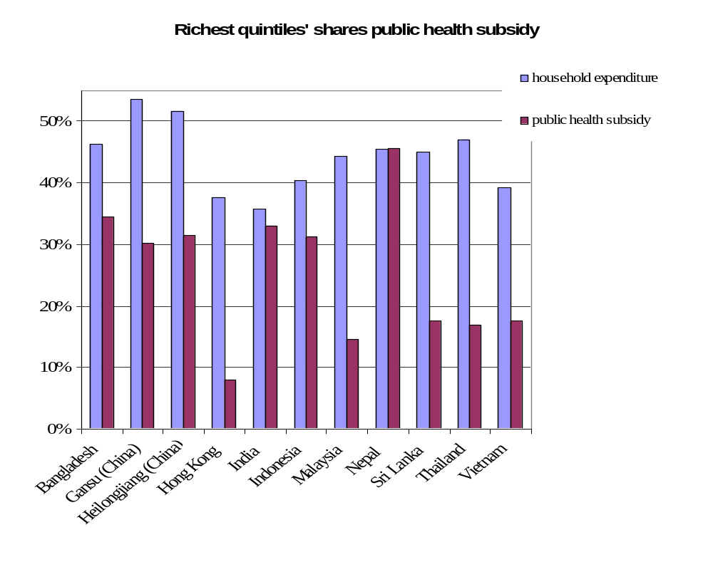
Rich’s share of public health subsidy in Asia

Slide 20
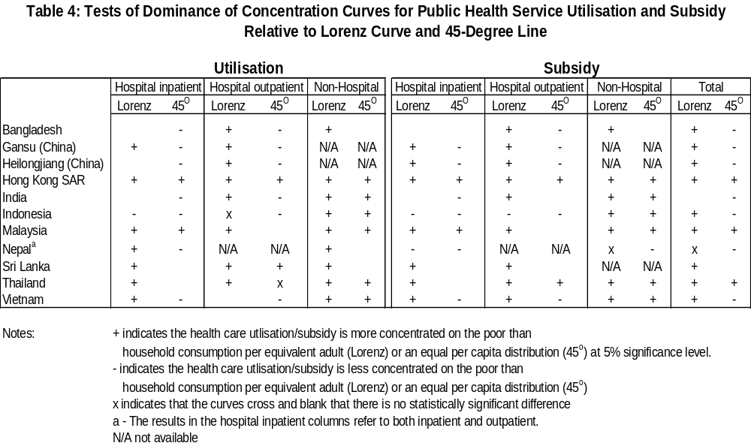
With a few exceptions, public health subsidies in Asia are pro-rich but inequality-reducing
Notes:
1. Dominance tests show that analysis based on the full distributions is consistent with that on quintile shares.

Slide 21
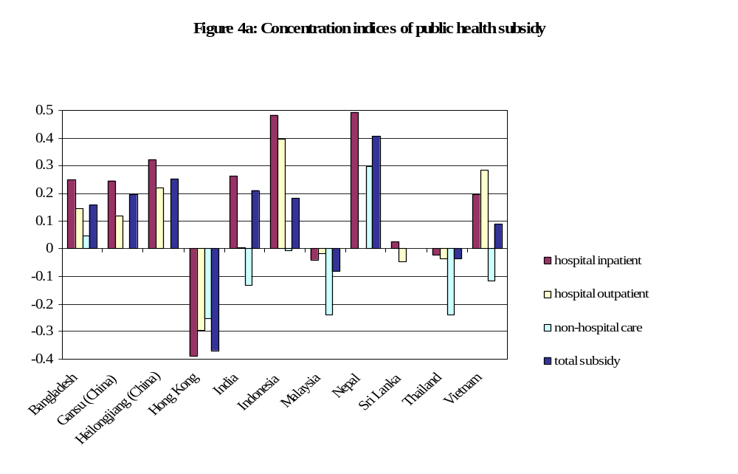
Public health subsidy is generally pro-rich in Asia

Slide 22
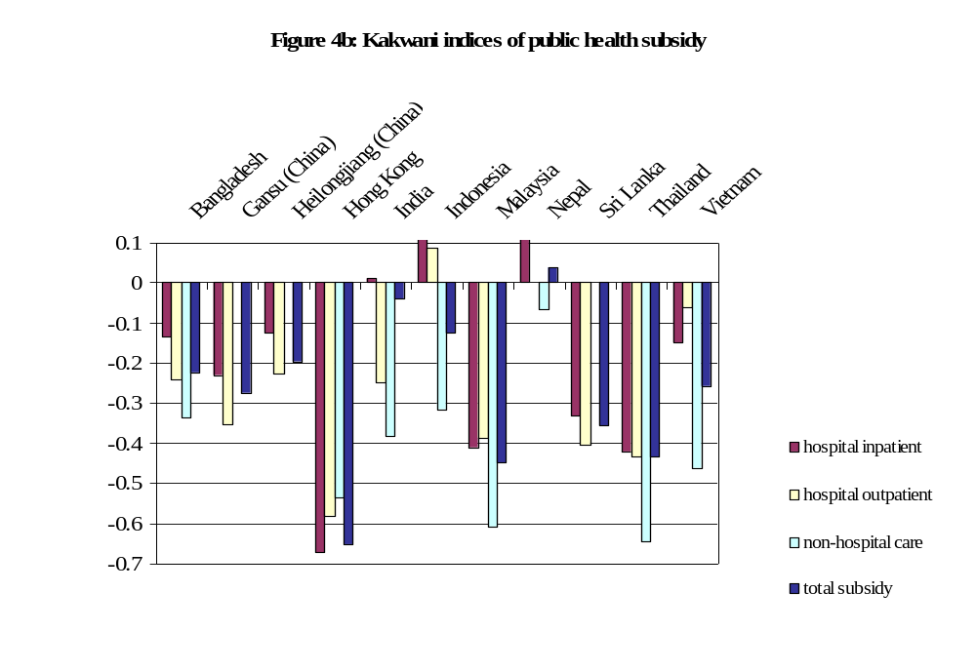
But inequality-reducing

Slide 23
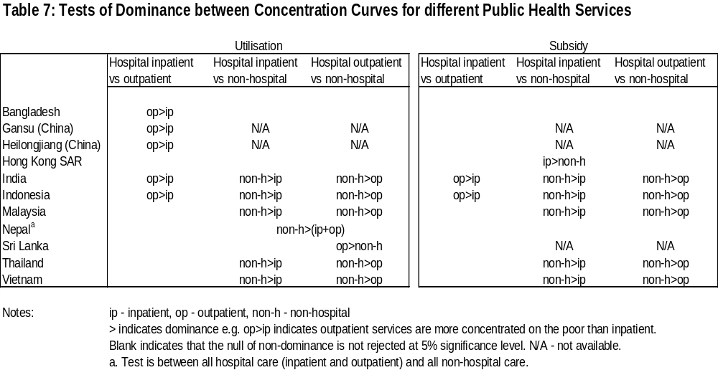
In general, non-hospital care is more pro-poor than hospital and outpatient less pro-rich than inpatient

Slide 24
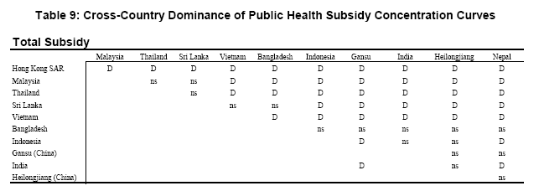
Cross-country differences in the distribution of the public health subsidy in Asia
Notes:
D indicates that the subsidy concentration curve for the country on the vertical dominates (is more pro-poor) than that for the country on the horizontal. For example, Hong Kong dominates Malaysia.
ns indicates no significant difference.

Slide 25
Summary of findings from Equitap BIA
Subsidy strongly pro-poor in Hong Kong
  Universal system with modest user charges and exemptions for poor
  Private sector alternative allows better-off to opt out
Among low/middle income countries, subsidy is slightly pro-poor in Malaysia & Thailand, neutral in Sri Lanka, slightly pro-rich in Vietnam and very pro-rich elsewhere.
Pro-rich bias stronger for inpatient than outpatient hospital care.
Non-hospital care is usually pro-poor.
But greatest share of subsidy goes to hospital care and this dominates distribution of total subsidy.

Slide 26
Is this good news or bad news?
Findings strengthen evidence base showing health subsidies are not pro-poor in developing countries.
If aim is to ensure poor get most of public health services, then failing.
But Malaysia, Thailand and Sri Lanka are exceptions.
If is part of wider policy to reduce relative differences in living standards, then succeeding.
Notes:
1. See O’Donnell, van Doorslaer et al (2007) for more on interpretation.

